Slide 1
Pathway analysis
Urmo Võsa
iBMS course 2017
FrankeSwertzLab
Department of Genetics
UMCG

Slide 2
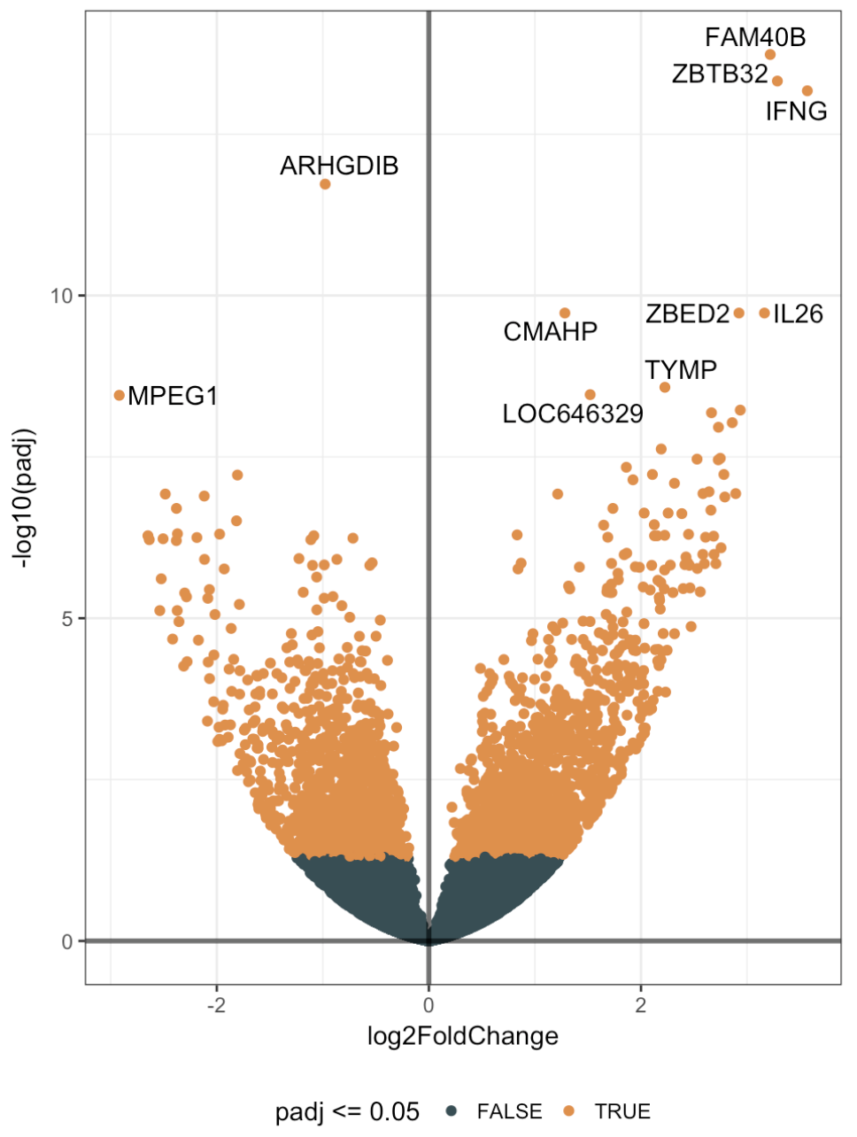
What next?

Slide 3
What next?
Basic science:
New knowledge about biological mechanisms of …
Practical aspects:
Diagnostic/prognostic biomarkers for the disease
Potential drug targets

Slide 4
What next?
Basic science:
New knowledge about biological mechanisms of …
Practical aspects:
Diagnostic/prognostic biomarkers for the disease
Potential drug targets
Find common themes from the results
Pinpoint potentially relevant genes
Put results into biological context

Slide 5
Pathway analysis Over-representation analysis

Slide 6
What is molecular pathway?
A molecular pathway is a series of interactions that occurs between the molecules and proteins within a cell and between cells.
http://www.geneticalliance.org/
Notes:
Put one simpler example first

Slide 7
What is molecular pathway?
Simplified MAPK pathway
Schmitt et al., 2016
Notes:
Put one simpler example first

Slide 8
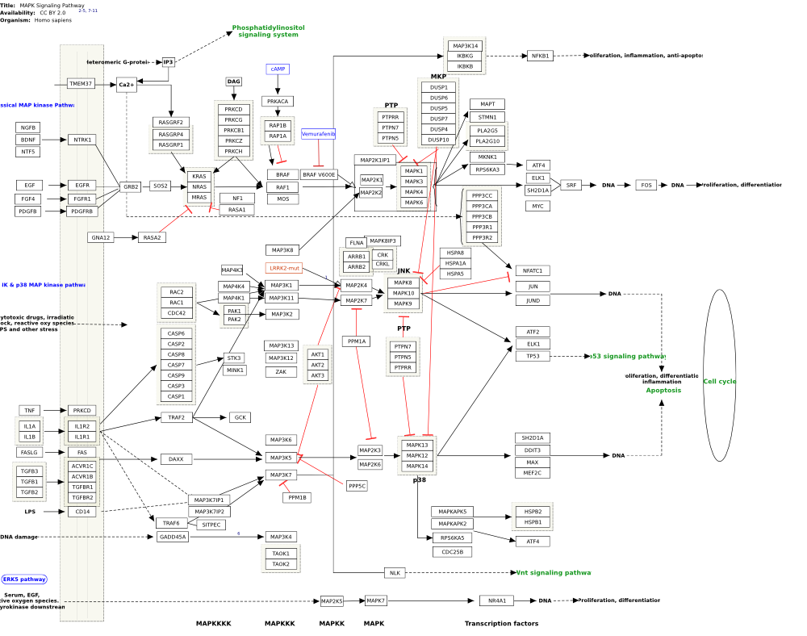
What is molecular pathway?
http://www.wikipathways.org/
Notes:
Put one simpler example first

Slide 9
Gene set
Any set of genes which shares some common theme:
on the shared pathway
share biological process/theme
share cellular localization
share common disease annotation
share common regulating transcription factor/microRNA
share common genomic location (chromosome band)
“genes associated with NIH grants”
…

Slide 10
Gene set is not pathway!

Slide 11
Pathway analysis Gene enrichment analysis

Slide 12
Some most widely used databases
Kyoto Encyclopedia of Genes and Genomes (KEGG)
www.genome.jp/kegg/

Slide 13
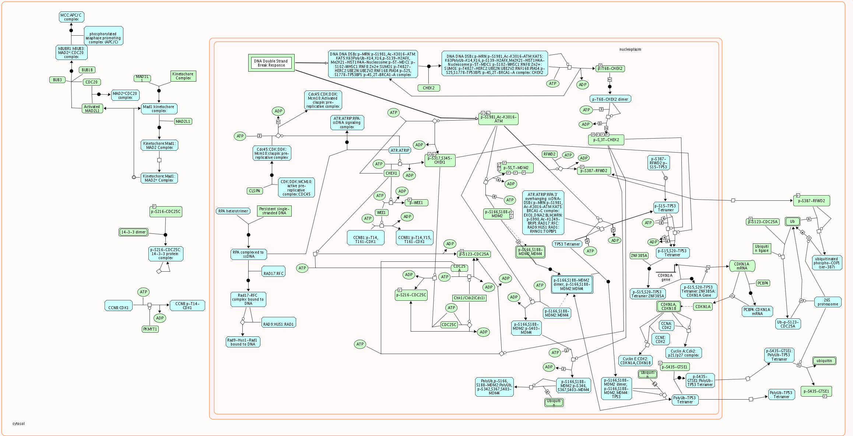
Some most widely used databases
REACTOME
www.reactome.org

Slide 14
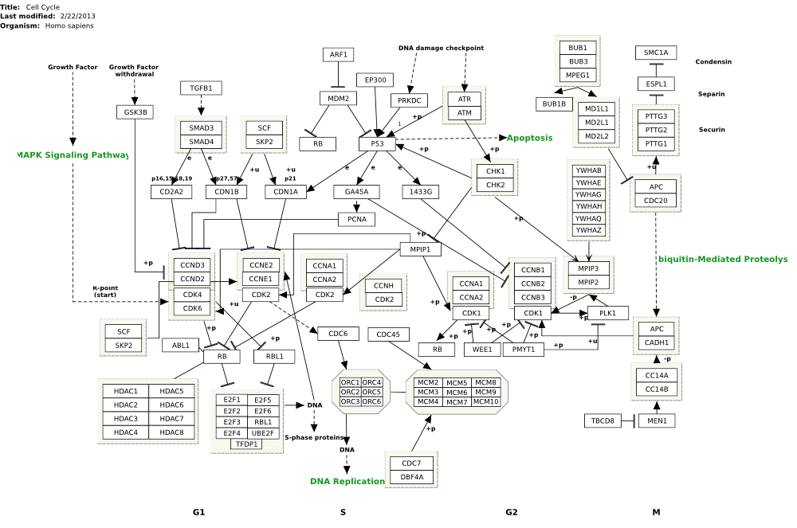
Some most widely used databases
WikiPathways
www.wikipathways.org

Slide 15
Some most widely used databases
Gene Ontology (GO):
Biological processes
Molecular function
Cellular composition
http://www.geneontology.org/
http://cbl-gorilla.cs.technion.ac.il/

Slide 16
Some most widely used databases
Gene Ontology (GO):
Biological processes
Molecular function
Cellular composition
Not exactly the pathway but gene set!
http://www.geneontology.org/
http://cbl-gorilla.cs.technion.ac.il/

Slide 17
Some most widely used databases
Gene Ontology (GO):
Biological processes
Molecular function
Cellular composition
Not exactly the pathway but gene set!
Gene set:
e.g. all genes part of BP GO:0000075
Cell cycle checkpoint
http://www.geneontology.org/
http://cbl-gorilla.cs.technion.ac.il/

Slide 18
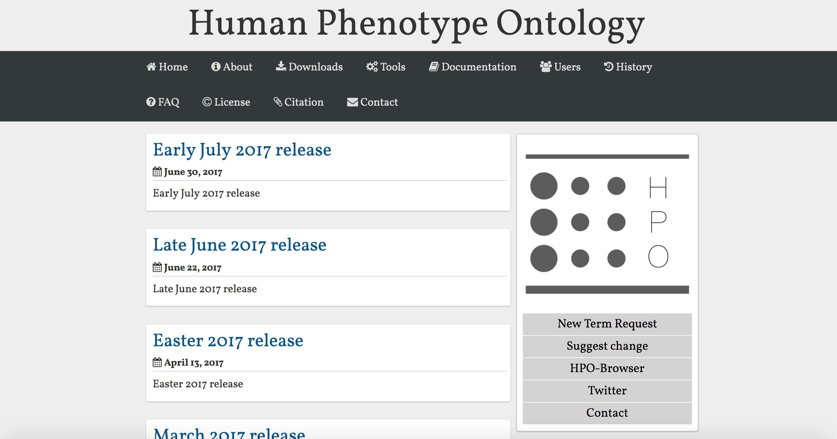
Some most widely used databases
Human Phenotype Ontology (HPO):
11,000 terms
115,000 hereditary diseases
4,000 common diseases
Not exactly the pathway but gene set!
Köhler et al., 2017
http://human-phenotype-ontology.github.io/

Slide 19
Some most widely used databases
Human Phenotype Ontology (HPO):
11,000 terms
115,000 hereditary diseases
4,000 common diseases
Not exactly the pathway but gene set!
Gene set:
e.g. all genes part of HP:0030359
Squamous cell lung carcinoma
Köhler et al., 2017
http://human-phenotype-ontology.github.io/

Slide 20
Gene enrichment analysis
Question: are genes of interest significantly enriched by some gene set (pathway/process/…)?

Slide 21
Gene enrichment analysis
Question: are genes of interest significantly enriched by some gene set (pathway/process/…)?
In our case: are the genes differentially expressed between Coeliac disease patients and control individuals over-represented by some specific biological themes?

Slide 22
Classification of pathway analysis methods
Overrepresentation analysis (ORA)
Hypergeometric test
Fisher’s exact test
Chi-squared test
Bayesian statistics
…
Functional class scoring (FCS)
GSEA
CAMERA
...
Topology-based methods (PT)
SPIA
...
Semantic similarity analyses
GoSemSim
...
Miscallaneous
GeneNetwork
...
Khatri et al., 2012 (Plos Comp. Biol. )

Slide 23
Classification of pathway analysis methods
Overrepresentation analysis (ORA)
Hypergeometric test
Fisher’s exact test
Chi-squared test
Bayesian statistics
…
Functional class scoring (FCS)
GSEA
CAMERA
…
Topology-based methods (PT)
SPIA
...
Semantic similarity analyses
GoSemSim
...
Miscallaneous
GeneNetwork
...
Khatri et al., 2012 (Plos Comp. Biol. )

Slide 24
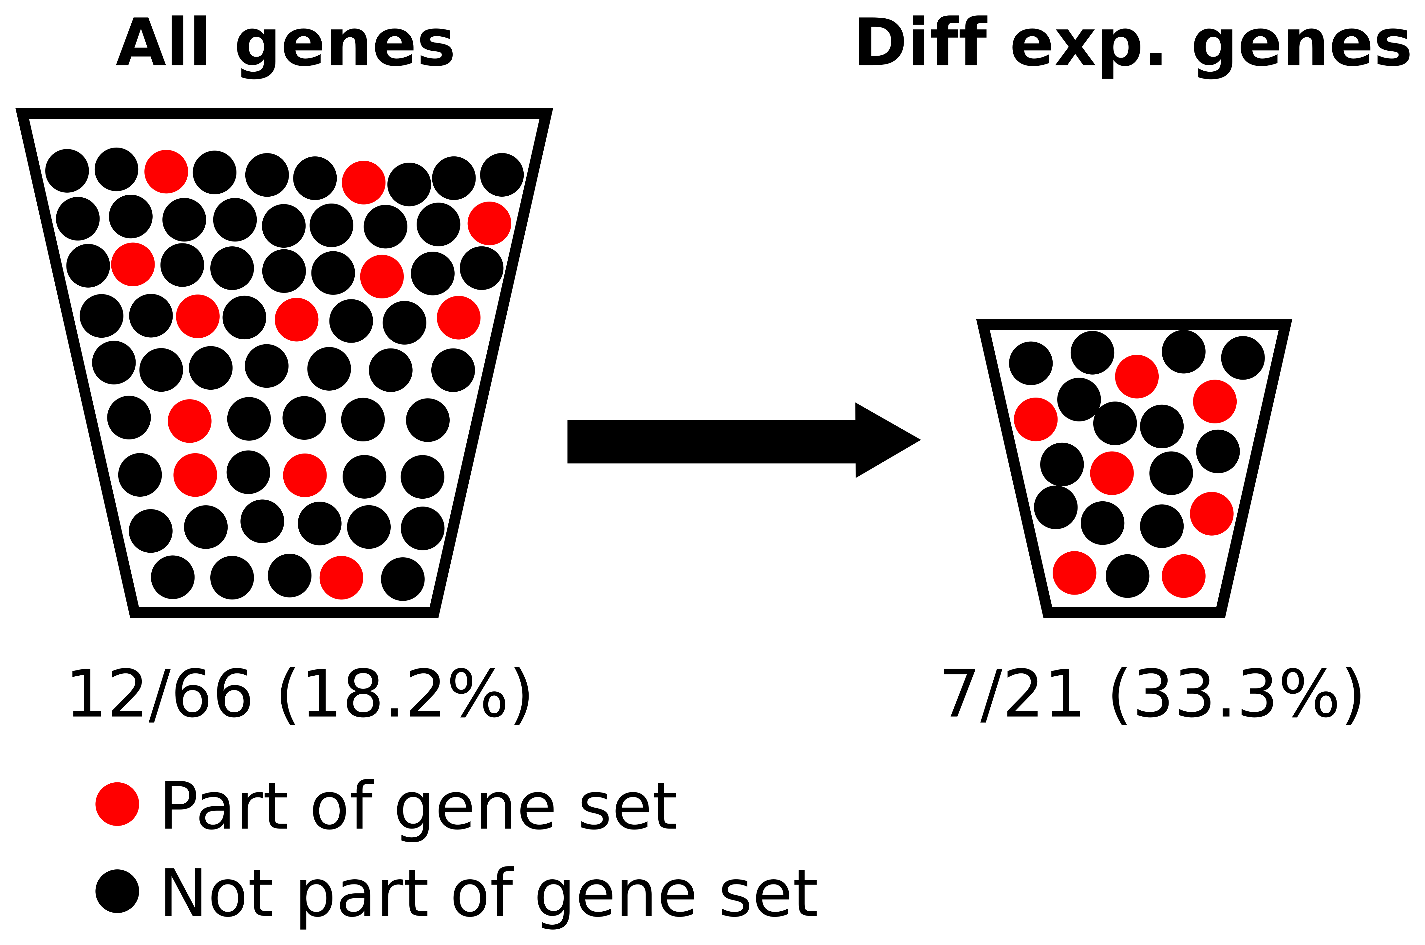
Over-representation analysis (ORA)
Uses the defined set genes of interest (e.g. diff. expressed genes)
Urn analogy:
Notes:
https://bmcbioinformatics.biomedcentral.com/articles/10.1186/s12859-017-1571-6

Slide 25
Over-representation analysis (ORA)
Uses the defined set genes of interest (e.g. diff. expressed genes)
Urn analogy:
Notes:
https://bmcbioinformatics.biomedcentral.com/articles/10.1186/s12859-017-1571-6

Slide 26
Over-representation analysis (ORA)
Uses the defined set genes of interest (e.g. diff. expressed genes)
Urn analogy:
Notes:
https://bmcbioinformatics.biomedcentral.com/articles/10.1186/s12859-017-1571-6

Slide 27
Over-representation analysis (ORA)
Uses the defined set genes of interest (e.g. diff. expressed genes)
Urn analogy:
Notes:
https://bmcbioinformatics.biomedcentral.com/articles/10.1186/s12859-017-1571-6

Slide 28
Over-representation analysis (ORA)
Uses the defined set genes of interest (e.g. diff. expressed genes)
Urn analogy:
Notes:
https://bmcbioinformatics.biomedcentral.com/articles/10.1186/s12859-017-1571-6

Slide 29
Most widely used method
Hypergeometric test (one-sided Fisher’s Exact Test)
 | Part of gene set | Not part of gene set | ∑
Diff. expressed | 7 | 21-7=14 | 21
Not. diff expressed | 12-7=5 | 66-21-(12-7)=40 | 45
∑ | 13 | 53 | 66
Notes:
https://bmcbioinformatics.biomedcentral.com/articles/10.1186/s12859-017-1571-6

Slide 30
Most widely used method
Hypergeometric test (one-sided Fisher’s Exact Test)
 | Part of gene set | Not part of gene set | ∑
Diff. expressed | 7 | 21-7=14 | 21
Not. diff expressed | 12-7=5 | 66-21-(12-7)=40 | 45
∑ | 12 | 54 | 66
Notes:
https://bmcbioinformatics.biomedcentral.com/articles/10.1186/s12859-017-1571-6

Slide 31
Most widely used method
Hypergeometric test (one-sided Fisher’s Exact Test)
 | Part of gene set | Not part of gene set | ∑
Diff. expressed | 7 | 21-7=14 | 21
Not. diff expressed | 12-7=5 | 66-21-(12-7)=40 | 45
∑ | 12 | 54 | 66
One-sided FET: P=0.036
Odds ratio: OR=3.9
Notes:
https://bmcbioinformatics.biomedcentral.com/articles/10.1186/s12859-017-1571-6

Slide 32
Multiple testing!
Usually many gene sets tests are done in parallel.
Multiple testing correction is needed to limit false positive results!
Bonferroni
FDR

Slide 33
Multiple testing!
Usually many gene sets tests are done in parallel.
Multiple testing correction is needed to limit false positive results!
Bonferroni
FDR

Slide 34
Gene Universe
“Gene Universe” AKA “Background”
The set of genes which could be identified by your analysis.
Often used: all annotated genes for investigated organism.
For diff. exp. analysis: all genes which were tested by your method.
It is not trivial to choose suitable background for more complex designs.
Incorrect selection of background may bias your analysis and lead to wrong conclusions!
Notes:
https://bmcbioinformatics.biomedcentral.com/articles/10.1186/s12859-017-1571-6

Slide 35
Limitations of ORA
Defining significance of the diff. expressed genes is often arbitrary.
All genes are treated with equal weight in the analysis.
Assumes the independence of the genes.

Slide 36
GSEA
Uses the full information from genes in the analysis
Small, non-significant but consistent expression changes are picked up by this analysis.
Ranks genes based on their effect size (e.g. strength of expression change)
Analyses whether genes in the top/bottom of the ranked list contain more pathway members as you would expect by chance.
NB! The term is often used interchangeably to designate ORA (confusing!)
Subramanian et al., 2005

Slide 37
GSEA algorithm
For each Gene Set:
Walk down from the ranked list of diff. exp. genes
Each time the gene is part of Gene Set: add value to the running sum. The increment is weighted by the correlation with phenotype (or fold change of diff expression).
Each time the gene is not part of Gene Set: subtract the weighted value from the running sum.
Enrichment score (ES) is the max. deviation of running sum from 0.
Subramanian et al., 2005

Slide 38
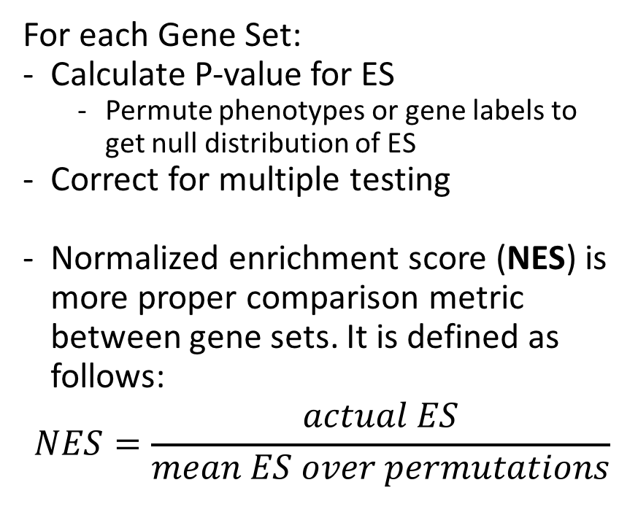
GSEA algorithm
For each Gene Set:
Calculate P-value for ES
Permute phenotypes or gene labels to get null distribution of ES
Correct for multiple testing
Normalized enrichment score (NES) is more proper comparison metric between gene sets. It is defined as follows:
$$NES=\frac{actual ES}{mean ES over permutations}$$
Subramanian et al., 2005

Slide 39
Some recommendations
Gene sets which are too small are usually not very trustworthy in ORA and GSEA.
Likewise, gene sets which are very big are difficult to interpret.

Slide 40
Web- or command-line tool?
Web-based tools
+ Easy to use
+ Often gives comprehensive report
Not replicable
Often out of date
Often “black box”
Often not flexible
Prone to mistakes
Command-line tools
+ Replicable
+ Very flexible
+ Parallelizable
+ Integratable to the pipelines
+ Smaller possibility to make mistakes
- Steep learning curve

